Slide 1


Introduction to Git & GitHub
https://git-scm.com/
https://github.com

Slide 2
I. Introduction to Git
A. What is Git?
B. Git workflow: Creating a new repo
C. HEAD
D. Basic Git commands
E. Concept of branches
F. Creating a branch / switching between branches
G. Merging branches and resolving conflicts
H. Concept of stashing
II. Introduction to GitHub
A. What is GitHub? Basic GitHub concepts
B. GitHub in practice: Distributed version control
C. Cloning a remote repo
D. Fetching/Pushing to a remote repo
E. Collaborating using Git and GitHub

Slide 3
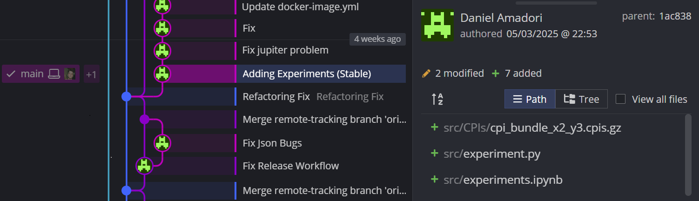
Version Control System
a way to manage files and directories
track changes over time
recall previous versions

Slide 4

Git
created by Linus Torvalds, April 2005
a command line version control program
uses checksums to ensure data integrity
cross-platform
open source, free

Slide 5
Repository
usually used to organize a single project
repos can contain:
folders, files, images, videos,
code and data sets
anything your project needs

Slide 6
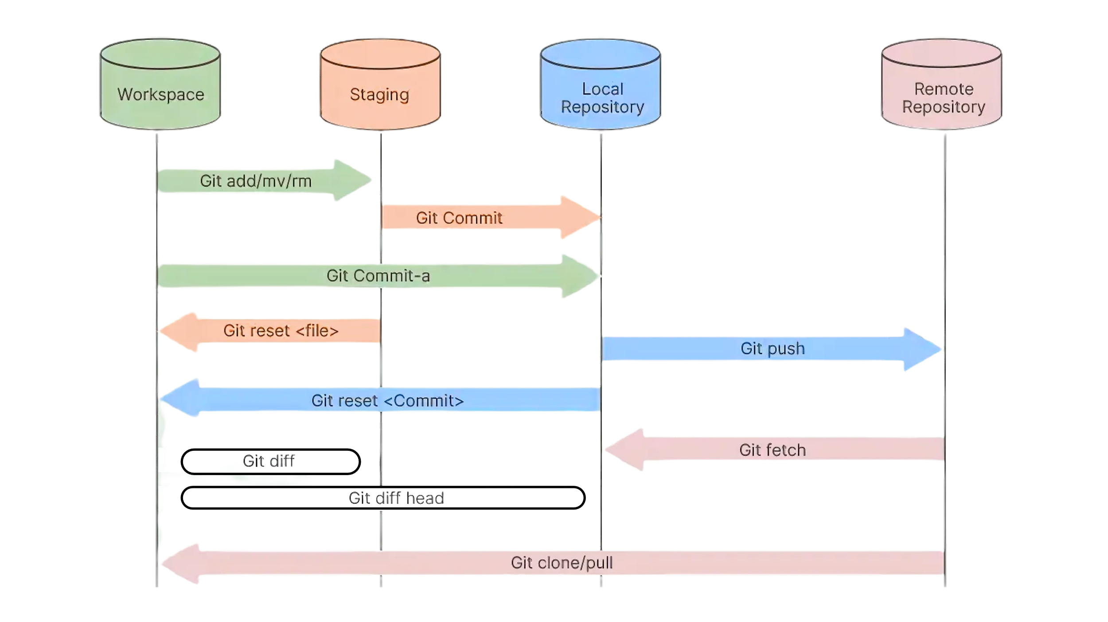
Git architecture

Slide 7
Before starting to use git
Setup your name and email so others can know who committed changes.
git config --global user.name “name”
git config --global user.email “email”
Note: set for all repositories on your computer
git config --local user.email “email”
Note: can set differently for each repository

Slide 8
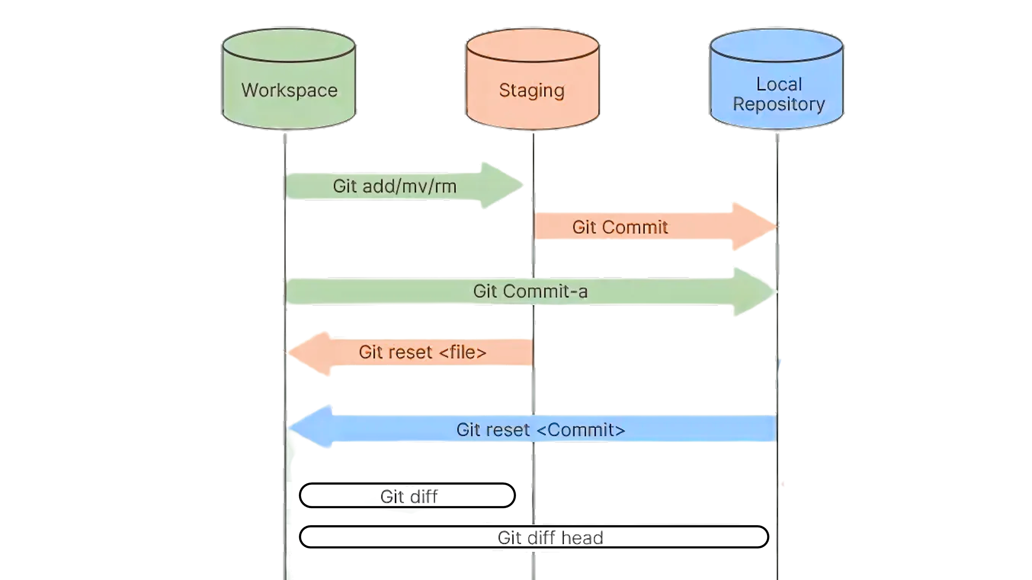
A simple Git workflow
Create a Project folder:
mkdir
Initialize a new project in a directory:
git init
Create a file:
touch <filename>
Add in the staged files:
git add <filename>
Commit the change to the repo:
git commit -m “important message here”
Watch changes:
git logs

Slide 9
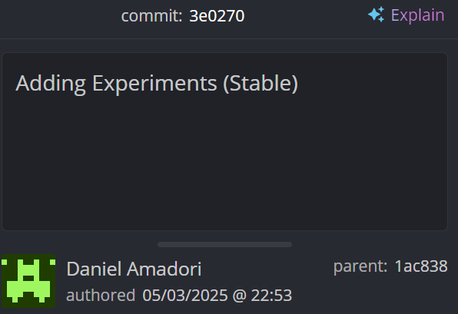
Commit messages
Tell what it does (present tense)
Single line summary followed by blank space followed by more complete description
Short summary of changes
More detailed explanatory text, if necessary.

Slide 10



SHAs
Checksums generated by SHA1 encryption algorithm
The HEAD pointer
points to a specific commit in repo
as new commits are made, the pointer changes
HEAD always refers to the latest commit on the currently active branch.

Slide 11
Basic Git Commands Overview
See where files are in the three tree scheme
git status
Committing and adding message
git commit –a
Allows one to add to staging index and commit at the same time
Grabs everything in working directory
Files not tracked or being deleted are not included
Compares changes to files between repo and working directory
git diff
Deleting files from the repo
git rm <filename>
moves deleted file change to staging area
It is not enough to delete the file in your working directory. You must commit the change.
Moving (renaming) files
git mv filename1.txt filename2.txt (Note: File file1.txt was committed to repo earlier)
Grabs the file from the repo, removing all changes since last commit
git checkout <filename>
Undo changes added to staging area
git reset HEAD <filename>

Slide 12
Branches in Git
allows one to try new ideas
If an idea doesn’t work, throw away the branch. Don’t have to undo many changes to master branch
If it does work, merge ideas into master branch.

Slide 13
Branch Management
Check current branch
git branch
Create a new branch
git checkout -b <branch>
Note: At this point, both HEADs of the branches are pointing to the same commit (that of master)
Switch to another branch
git checkout <branch>
At this point, one can switch between branches, making commits, etc. in either branch, while the two stay separate from one another.
Note: In order to switch to another branch, your current working directory must be clean (no conflicts, resulting in data loss).
Compare two branches
git diff <branch1>..<branch2>

Slide 14
Merge Branches
Merge from the branch into which you want to merge another branch
git merge <branch to merge>
Note: Always have a clean working directory when merging

Slide 15
Merge Branches
Merge from the branch into which you want to merge another branch
git merge <branch to merge>
Note: Always have a clean working directory when merging
So easy?

Slide 16
Merge Branches
Merge from the branch into which you want to merge another branch
git merge <branch to merge>
Note: Always have a clean working directory when merging
So easy?
What if there are two changes to the same line in two different commits?

Slide 17
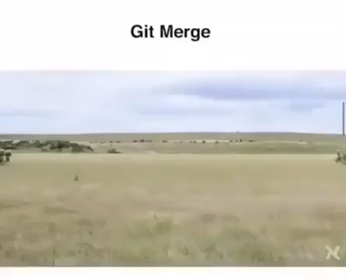
Merge conflicts
https://www.reddit.com/r/ProgrammerHumor/comments/cgf0b8/git_merge/#lightbox

Slide 18
Merge Branches
Resolving merge conflicts
Abort the merge using
git merge --abort
2. Manually fix the conflict
Note: Git will notate the conflict in the files!

Slide 19
Understanding a Merge Conflict
When Git detects conflicting changes, it marks them in your file using:
<<<<<<< HEAD
Changes from your branch
=======
Changes from the other branch
>>>>>>> branch-name
You must manually resolve the conflict:
Choose one side’s changes
Combine both
Rewrite the content
Remove all conflict markers after editing.

Slide 20
Tips to reduce merge pain
Merge Often
Integrate changes regularly to catch conflicts early, while they’re easier to fix.
Keep Commits Small & Focused
Write commits that solve one issue at a time, is easier to review, test, and roll back
Regularly Pull from Main
Keep your feature branch up to date using 'git pull origin main' or 'git rebase' to reduce conflict risk.

Slide 21
Renaming and deleting branches
git branch -m/--move <old name> <new name>
git branch -d <branch name>
Note: Must not be in <branch name>
Must not have commits in <branch name> unmerged in branch from which you are deleting
git branch -D <branch name>
Note: If you are really sure that you want to delete branch with commits

Slide 22
Managing Work with Git Stash
Allows you to save your work and change branch
git stash save “message”
Note: used for switching quickly between branches
don’t leave the code in stash for a long period of time
Lists all current stashes
git stash list
Applies and deletes the most recent stash
git stash pop <index>
Applies a stash but keeps it in the list
git stash apply <index>
Creates a new branch starting from a stash
git stash branch <branch name> <index>
Note: useful for long-term feature development.

Slide 23
GitHub
Platform to host code repositories
launched in 2007
most popular Git host
allows users to collaborate on projects from anywhere
GitHub makes git social!
Free to start (can pay for private repositories and additional features)
https://github.com

Slide 24
Git architecture

Slide 25
Other Git Commands
Copying (cloning) files from remote repo to local machine
git clone URL <new dir name>
Pushing to a remote repo
git push <remote name> <branch name>
Fetch
git fetch <remote repo name>
Note:
doesn’t change your working dir or any commits that you’ve made
git merge must be done to merge fetched changes into local branch
Fetch and merge changes to local branch and working directory
git pull <remote repo name>

Slide 26
Other Git Commands
Link my local repo to a remote repo
git remote add <alias> <URL>
Note: just establishes a connection…no files are copied/moved
You may have more than one remote linked to your local directory!
Tag specific points in history as being important, such as releases versions (v.1.0, 2.0, …)
git tag

Slide 27
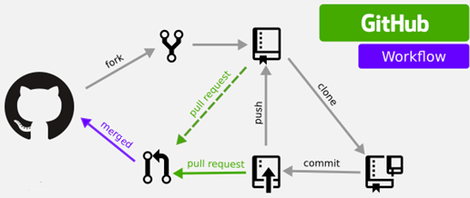
Forking a Repository (GitHub)
Click “Fork” on a repository page on GitHub
What it does:
Creates a personal copy of someone else's repository in your own GitHub account
Allows you to freely experiment, edit, or contribute without affecting the original
Why it matters:
Essential for open-source collaboration
Used in the 'Fork and Pull Request' workflow
Typical flow:
1. Fork a repo on GitHub
2. Clone your fork locally:
3. Create a branch, make changes, push, then open a pull request
https://levelup.gitconnected.com/how-to-sync-forked-repositories-using-git-or-github-2933e497fa16

Slide 28
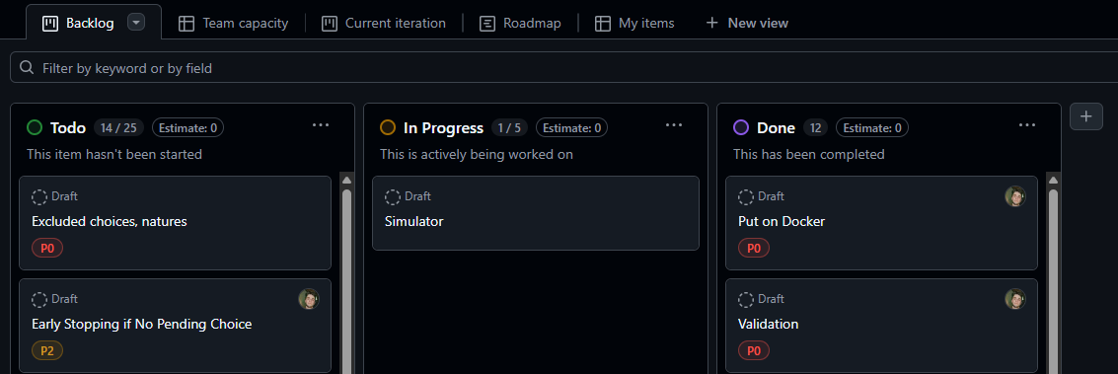
GitHub Projects (Backlog)
Backlog:
prioritized list of work items that need to be completed (features, bugs, and tasks)
In Agile:
Contains user stories, tasks, and issues
Continuously updated and reprioritized

Slide 29
Resources
Git: https://git-scm.com/
Try GitHub: https://try.github.io/

